Slide 1
Online Optimization of Power Networks
Changhong Zhao
Lingwen Gan
Steven Low
EE, CMS, Caltech
Enrique Mallada
ME, Johns Hopkins
January 2016
Notes:
May 2012: Santa Fe Institute Workshop on Smart Grid, Santa Fe, NM
July 2012: Network Science Workshop, Chinese University of Hong Kong, HK (Raymond Yeung)
Sept 2012: Melbourne University, EEE Department (Pascal van Hentenryck)
February 13, 2013: ITA Workshop, San Diego
May 20, 2013: IEEE Workshop on Modeling and Simulation of Cyber-Physical Energy Systems, Berkeley, CA (Peter Palensky, Edward A. Lee)
Oct 31, 2013: Google, Mountain View, CA (Arun Mazumdar)
Nov 5, 2013: Asilomar Conference, invited session on Power Networks (Edmund Yeh)
Nov 15, 2013: NSF Workshop on Smart Grid, Washington DC (Giannakis, Sairaj, SL)
Dec 2, 2013: UCLA EE (Mani Srivastava)
Dec 5, 2013: Keynote, GlobalSIP (Global Conf on Signal & Info Processing) Symposium on Signal Processing in Smart Grid (Shalinee Kishore, Lalitha Sankar)
Jan 16, 2014: Stanford Smart Grid seminar (Ram Rajagopal, Baosen Zhang)
Feb 4, 2014: 9th Annual CARNEGIE MELLON CONFERENCE ON THE ELECTRICITY INDUSTRY, (Marija Ilic, Krishnan Kant)
May 22, 2014: UC Berkeley (Kameshwar)
Oct 3, 2014: ASU (Junshan Zhang)
Nov 3, 2014: Asilomar Conference, invited session on Smart Grid: learning and optimization, Pacific Grove, CA
Nov 10, 2014: EE Control Group, Berkeley (Claire Tomlin)
Jan 16, 2015, Grid Science Winter School and Conference (Scott Backhaus, Misha Chertkov)
June 9, 2015: Advanced Mathematical Methods For Energy Systems: from Theory to Practice, Moscow, Russia (Janusz Bialek, Skoltech)
July 7, 2015, Tsinghua power systems group (Prof Song Yonghua)
July 21, 2015: Hong Kong University, EEE (David Hill, Victor Li)
Online algorithms for power systems
============================
Jan 14, 2016: IPAM Workshop on Optimization and Equilibrium of Energy Economics, UCLA, CA (Mike Ferris)
Jan 28, 2016: ESIF Workshop on Frontiers in Distributed Optimization and Control of Sustainable Power Systems, NREL, Golden, CO (Emiliano Dall’Anese, Brian Johnson)
Feb 10, 2016: Georgia Tech, School of Industrial & Systems Engineering (Andy Sun)

Slide 2
Key message
Large network of DERs
Real-time optimization at scale
Computational challenge: power flow solution
Online optimization (feedback control)
Network solves hard problem in real time for free
Exploit it for our optimization/control
Naturally adapts to evolving network conditions
Examples
Slow timescale: OPF
Fast timescale: frequency control

Slide 3
Outline
Optimal power flow
DistFlow model and ACOPF
Online algorithm
Analysis and simulations
Load-side frequency control
Dynamic model & design approach
Distributed online algorithm
Analysis and simulations
Details
Gan & L, JSAC 2016
Zhao, Topcu, Li, L, TAC 2014
Mallada, Zhao, L, Allerton 2014
Zhao et al: CDC 2014, CISS 2015, PSCC 2016

Slide 4
Bus injection model
Power flow equations
OPF = QCQP ➔ SDP relaxation

Slide 5
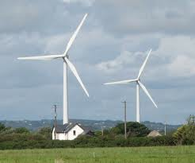

Branch flow model
j
k
directed graph G

Slide 6
Branch flow model
Branch flow model
linear
quadratic
DistFlow equations (radial nk)
Baran & Wu, 1989

Slide 7
Branch flow model
Bus injection model
Branch flow model
DistFlow equations (radial nk)
Baran & Wu, 1989

Slide 8
Branch flow model
Bus injection model
Branch flow model
+ cycle condition on

Slide 9
Cycle condition
A relaxed solution satisfies the cycle condition if
incidence matrix;
depends on topology

Slide 10
Branch flow model
Bus injection model
Branch flow model
+ cycle condition on
Theorem: BIM = BFM
[Farivar & Low 2013 TPS
Bose et al 2012 Allerton]

Slide 11
Branch flow model
BFM and BIM are equivalent (nonlinear bijection)
… but some results are easier to formulate or
prove in one than the other
BFM is much more numerically stable
BFM is useful for radial networks
Extremely efficient computation (BFS)
Much better linearization
Compact extension to multiphase unbalanced nk
Gan & L PSCC 2014

Slide 12
Branch flow model
Bus injection model
Branch flow model
+ cycle condition on

Slide 13
SOCP relaxation
Bus injection model
Branch flow model

Slide 14
SOCP relaxation of OPF

Slide 15
Sufficient conds for exact relaxation
For mesh networks, see recent works of Andy Sun, Pascal van Hentenryck on
relaxation of cycle condition
Tutorial: Convex relaxation of OPF, IEEE Trans. Control of Network Systems, 2014

Slide 16
Sufficient conds for exact relaxation
For mesh networks, see recent works of Andy Sun, Pascal van Hentenryck on
relaxation of cycle condition
Tutorial: Convex relaxation of OPF, IEEE Trans. Control of Network Systems, 2014

Slide 17
SOCP relaxation of OPF
But all these algorithms are offline …
… unsuitable for real-time optimization of
network of distributed energy resources

Slide 18
SOCP relaxation of OPF
We will compare our online algorithm to
SOCP relaxation wrt optimality and speed

Slide 19
OPF
controllable devices
F(x, y) = 0
BFM
uncontrollable state

Slide 20
OPF
controllable devices
F(x, y) = 0
BFM (DistFlow, radial network)

Slide 21
Eliminate y from OPF

Slide 22
Online (real-time) perspective
measurement,
communication
y(t)
control
x(t)
Bolognani et al arXiv 2013
Gan & Low JSAC 2016
Dall’Anese & Simonetto 2016

Slide 23
Approximate OPF
add log barrier function
to objective to remove
voltage constraints
L: nonconvex

Slide 24
Approximate OPF
Recap: OPF → approximate OPF
Reduce to x only by eliminating y using power flow equations
Add barrier function on v(x) to remove voltage constraints

Slide 25
Online gradient algorithm
gradient projection algorithm:
active control
law of physics
Explicitly exploits network to carry out part of algorithm
Algorithm naturally tracks changing network conditions

Slide 26
Online gradient algorithm
gradient projection algorithm:
active control
law of physics
Results
Local optimality
Global optimality
Suboptimality bound
[Gan & Low JSAC 2016]

Slide 27
Local optimality
x(t) converges to set of local optima
if #local optima is finite, x(t) converges

Slide 28
Global optimality
Theorem
If all local optima are in A then
x(t) converges to the set of global optima
x(t) itself converges a global optimum if #local optima is finite

Slide 29
Global optimality
Theorem
If SOCP is exact over X, then assumption holds

Slide 30
Suboptimality gap
any original
feasible pt
slightly away
from boundary
any local
optimum
Informally, a local minimum is almost as good
as any strictly interior feasible point

Slide 31
Simulations

Slide 32
Outline
Optimal power flow
DistFlow model and ACOPF
Online algorithm
Analysis and simulations
Load-side frequency control
Dynamic model & design approach
Distributed online algorithm
Analysis and simulations
Details
Gan & L, JSAC 2016
Zhao, Topcu, Li, L, TAC 2014
Mallada, Zhao, L, Allerton 2014
Zhao et al: CDC 2014, CISS 2015, PSCC 2016

Slide 33
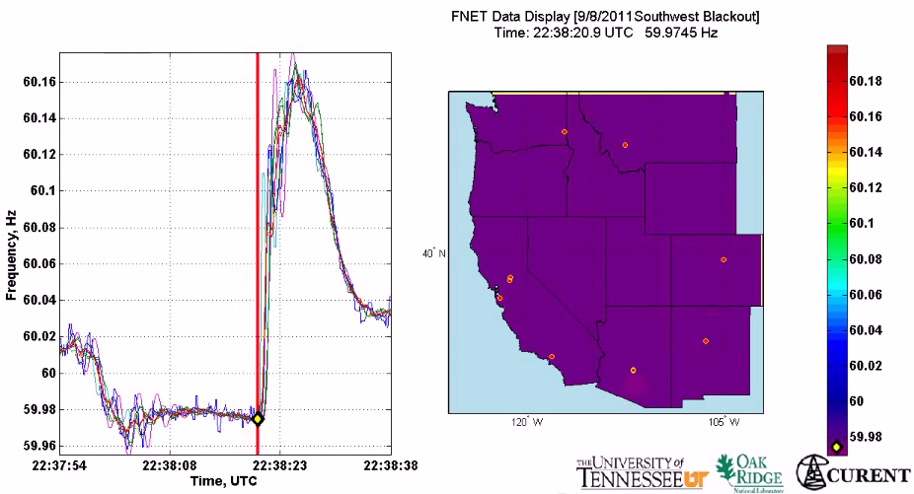
Motivation
All buses synchronized to same nominal frequency (US: 60 Hz; Europe/China: 50 Hz)
Supply-demand imbalance ➔ frequency fluctuation
(1 min)
2011 Southwest blackout

Slide 34
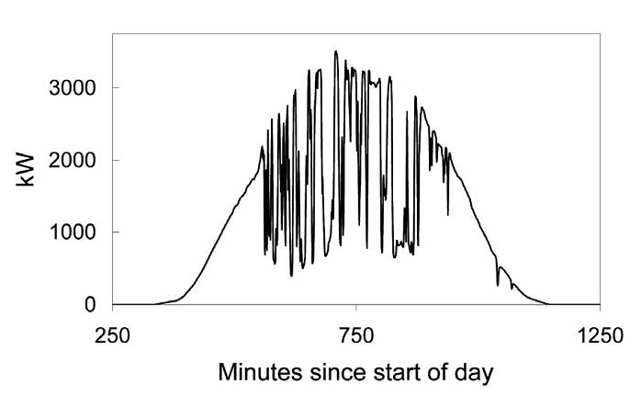
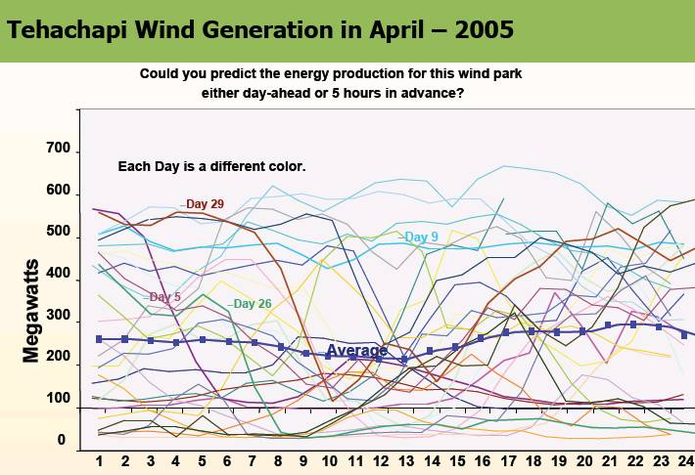
Motivation
Imagine when we have 50%+ renewable generation …
(10 min)
(1 min)

Slide 35
Why load-side participation
Ubiquitous continuous load-side control can supplement generator-side control
faster (no/low inertia)
no extra waste or emission
more reliable (large #)
better localize disturbances
reducing generator-side control capacity
secondary freq control
economic
dispatch
primary
freq control
sec
min
5 min
60 min

Slide 36
What is the potential
Residential load accounts
for ~1/3 of peak demand
61% residential appliances
are Grid Friendly
US:
operating reserve: 13% of peak
total GFA capacity: 18%
Lu & Hammerstrom (2006), PNNL

Slide 37
How
How to design load-side frequency control ?
How does it interact with generator-side control ?

Slide 38
Literature: load-side control
Original idea & early analytical work
Schweppe et al 1980; Bergin, Hill, Qu, Dorsey, Wang, Varaiya …
Small scale trials around the world
D.Hammerstrom et al 2007, UK Market Transform Programme 2008
Early simulation studies
Trudnowski et al 2006, Lu and Hammerstrom 2006, Short et al 2007, Donnelly et al 2010, Brooks et al 2010, Callaway and I. A. Hiskens, 2011, Molina-Garcia et al 2011
Analytical work – load-side control
Zhao et al (2012/2014), Mallada and Low (2014), Mallada et al (2014), Zhao and Low (2014), Zhao et al (2015)
Simpson-Porco et al 2013, You and Chen 2014, Zhang and Papachristodoulou (2014), Ma et al (2014), Zhao, et al (2014),
Recent analysis – generator-side/microgrid control:
Andreasson et al (2013), Zhang and Papachristodoulou (2013), Li et al (2014), Burger et al (2014), You and Chen (2014), Simpson-Porco et al (2013), Hill et al (2014), Dorfler et al (2014)

Slide 39
Network model
branch power
generation
Will include generator-side
control later
loads:
controllable + freq-sensitive
i : region/control area/balancing authority

Slide 40
Network model
Generator bus: M_{i} > 0
Load bus: M_{i} = 0
Damping/uncontr loads:
Controllable loads:

Slide 41
Network model
swing dynamics
all variables are deviations
from nominal
extends to nonlinear power flow

Slide 42
Frequency control
Suppose the system is in steady state
Then: disturbance in gen/load …

Slide 43
Frequency control
current
approach
load-side
control

Slide 44
Outline
Network model
Distributed online algorithm
Simulations
Details
Main references (frequency control):
Zhao, Topcu, Li, L, TAC 2014
Mallada, Zhao, L, Allerton 2014
Zhao et al: CDC 2014, CISS 2015, PSCC 2016

Slide 45
Load-side controller design
Control goals (while min disutility)
Rebalance power & stabilize frequency
Restore nominal frequency
Restore scheduled inter-area flows
Respect line limits
Zhao, Topcu, Li, Low
TAC 2014
Mallada, Zhao, Low
Allerton, 2014

Slide 46
Load-side controller design
Control goals (while min disutility)
Rebalance power & stabilize frequency
Restore nominal frequency
Restore scheduled inter-area flows
Respect line limits
Zhao, Topcu, Li, Low
TAC 2014
Mallada, Zhao, Low
Allerton, 2014

Slide 47
Load-side controller design
Design control law
whose equilibrium
solves:
load disutility
power balance
inter-area flows
line limits
Control goals (while min disutility)
Rebalance power & stabilize frequency
Restore nominal frequency
Restore scheduled inter-area flows
Respect line limits
freq will emerge as
Lagrange multiplier
for power imbalance

Slide 48
Load-side controller design
Design control (G, F) s.t. closed-loop system
is stable
has equilibrium that is optimal
power network
load control

Slide 49
Load-side controller design
Idea: exploit system dynamic as part of primal-dual algorithm for modified opt
Distributed algorithm
Stability analysis
Control goals in equilibrium
power network
load control

Slide 50
Summary: control architecture
physical network
Primary load-side frequency control
completely decentralized
Theorem: stable dynamic, optimal equilibrium
Zhao, Topcu, Li, Low. TAC 2014

Slide 51
Summary: control architecture
physical network
cyber network
Secondary load-side frequency control
communication with neighbors
Theorem: stable dynamic, optimal equilibrium
Mallada, Zhao, Low. Allerton 2014

Slide 52
Summary: control architecture
physical network
cyber network
With generator-side control, nonlinear power flow
load-side improves both transient & eq
Theorem: stable dynamic, optimal equilibrium
Zhao, Mallada, Low. CISS 2015

Slide 53
Outline
Network model
Load-side frequency control
Simulations
Details
Main references (frequency control):
Zhao, Topcu, Li, L, TAC 2014
Mallada, Zhao, L, Allerton 2014
Zhao et al: CDC 2014, CISS 2015, PSCC 2016

Slide 54
Local frequencies
[Tom Overbye, 2015 Cornell]

Slide 55
Simulations
Dynamic simulation of IEEE 39-bus system
Power System Toolbox (RPI)
Detailed generation model
Exciter model, power system
stabilizer model
Nonzero resistance lines

Slide 56
Primary control

Slide 57
Secondary control
swing dynamics
with OLC
area 1

Slide 58
Secondary control
line limit
no line limits
Total inter-area flow is
the same in both cases
line limit
with line limits

Slide 59
Key message
Large network of DERs
Real-time optimization at scale
Computational challenge: power flow solution
Online optimization (feedback control)
Network solves hard problem in real time for free
Exploit it for our optimization/control
Naturally adapts to evolving network conditions
Examples
Slow timescale: OPF
Fast timescale: frequency control

Slide 60
more details
(backup)

Slide 61
Recall: design approach
Idea: exploit system dynamic as part of primal-dual algorithm for modified opt
closed-loop system is stable
its equilibria are optimal
power network
load control

Slide 62
Outline
Load-side frequency control
Primary control
Secondary control
Interaction with generator-side control
Zhao et al SGC2012, Zhao et al TAC2014

Slide 63
Optimal load control (OLC)
demand = supply
disturbances
controllable
loads

Slide 64
system dynamics + load control = primal dual alg
swing dynamics
implicit
load control
active control

Slide 65
Control architecture

Slide 66
Load-side primary control works
Theorem
Starting from any
system trajectory
converges to
is unique optimal of OLC
is unique optimal for dual
completely decentralized
frequency deviations contain right info for local decisions that are globally optimal

Slide 67
Recap: control goals
Rebalance power
Stabilize frequencies
Restore nominal frequency
Restore scheduled inter-area flows
Respect line limits
Yes
Yes
No
No
No

Slide 68
Outline
Load-side frequency control
Primary control
Secondary control
Interaction with generator-side control
Mallada, Low, IFAC 2014
Mallada et al, Allerton 2014

Slide 69
OLC for secondary control
demand = supply
restore nominal freq

Slide 70
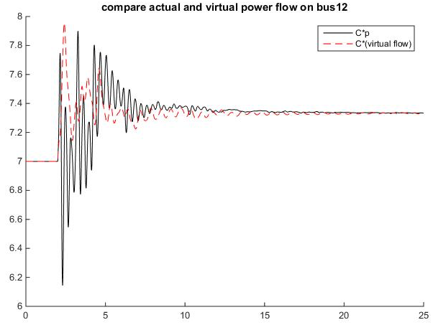
OLC for secondary control
demand = supply
restore nominal freq
key idea: “virtual flows”
in steady state:
virtual flow = real flows

Slide 71
OLC for secondary control
demand = supply
restore nominal freq
restore inter-area flow
respect line limit
in steady state:
virtual flow = real flows

Slide 72
Recall: primary control
swing dynamics:
implicit
active
control
load control:

Slide 73
Control architecture
physical network
cyber network

Slide 74
Secondary frequency control
load control:
computation & communication:
primal var:
dual vars:

Slide 75
Secondary control works
Theorem
starting from any initial point, system
trajectory converges s. t.
is unique optimal of OLC
nominal frequency is restored
inter-area flows are restored
line limits are respected

Slide 76
Recap: key ideas
Design optimal load control (OLC) problem
Objective function, constraints
Derive control law as primal-dual algorithms
Lyapunov stability
Achieve original control goals in equilibrium
Distributed algorithms
primary control:
secondary control:

Slide 77
Recap: key ideas
Design optimal load control (OLC) problem
Objective function, constraints
Derive control law as primal-dual algorithms
Lyapunov stability
Achieve original control goals in equilibrium
Distributed algorithms
Virtual flows
Enforce desired properties on line flows
in steady state: virtual flow = real flows

Slide 78
Recap: control goals
Rebalance power
Resynchronize/stabilize frequency
Restore nominal frequency
Restore scheduled inter-area flows
Respect line limits
Yes
Yes
Zhao, et al TAC2014
Yes
Yes
Yes
Mallada, et al Allerton2014
Secondary control restores nominal
frequency but requires local communication

Slide 79
Outline
Load-side frequency control
Primary control
Secondary control
Interaction with generator-side control
Zhao and Low, CDC2014
Zhao, Mallada, Low, CISS 2015
Zhao, Mallada, Low, Bialek, PSCC 2016

Slide 80
Generator-side control
New model: nonlinear PF, with generator control
Recall model: linearized PF, no generator control

Slide 81
Generator-side control
New model: nonlinear PF, with generator control
generator bus: real power injection
load bus: controllable load

Slide 82
Generator-side control
New model: nonlinear PF, with generator control
generator buses:

Slide 83
Load-side control
physical network
cyber network

Slide 84
Load-side primary control works
Theorem
Every closed-loop equilibrium solves OLC and its dual
Suppose
Any closed-loop equilibrium is (locally) asymptotically stable provided

Slide 85
Conclusion
Forward-engineering design facilitates
explicit control goals
distributed algorithms
stability analysis
Load-side frequency regulation
primary & secondary control works
helps generator-side control

Slide 86
Key message
Large network of DERs
Real-time optimization at scale
Computational challenge: power flow solution
Online optimization (feedback control)
Network solves hard problem in real time for free
Exploit it for our optimization/control
Naturally adapts to evolving network conditions
Examples
Slow timescale: OPF
Fast timescale: frequency control

